Slide 1

Uhcl-CSE portal
Team-tech dudes
Soundarya amba raja
Akshitha vaddi
Bharath Gandham
Ravitheja vodapally

Slide 2
Contents
Problem Statement
Requirements Gathering
Design
Screenshots and Demo
Task division
Timeline

Slide 3
Problem statements
E-mails for conducting a meeting
Attendance on a paper
Using e-mails for Meeting minutes and comments.
Lot of paper work is done and stacked at each faculty’s table.
Difficult to search a meeting from a log of papers.

Slide 4
Problem statements continued
Admission and Waiver dept runs on paper work.
Applications are carried “In-person” from one place to other.
Reviewing the applications one after the other, can’t make it simultaneously.
Using mail trays in the absence of an authorized faculty.

Slide 5
Requirements gathering
Business Requirements
Website for conducting Meetings
Enables chair to send automated emails for the faculty.
Providing access to upload pdf where faculty can access.
Access to upload a Admission, waiver forms.
Role based Authorization

Slide 6
Functional requirements
Meeting minutes
Microsoft Authentication for user login
Creating roles and accessibility for Admin, chain and faculty.
Notifying faculty about meeting and agenda.
Meeting minutes should be edited by Dept. Chair
Providing a Search functionality to pull a meeting.
Approvals, Declines and comments .
Access to Upload Files and take Attendance

Slide 7
Continuation…
Student’s application / waiver
Access for admission dept and waiver dept to upload a pdf.
Authorized members are notified about the new applications.
Giving access to approve or decline the applications with necessary comments.
Each dept should be able to see the approvals to take a decision.
A status is shown if approved or declined.

Slide 8
System Requirements
Microsoft Azure – Active Directory Services
Angular 8, Angular Material Modules and PrimeNG Modules
Microsoft Authentication
Firebase– DB, Storage, Authentication
JavaScript/ TypeScript
HTML , CSS/Bootstrap
GITHUB – Version Controls

Slide 9
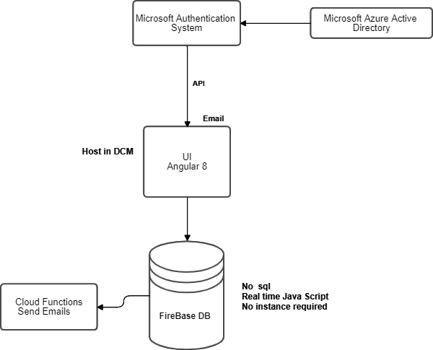
System Architecture

Slide 10
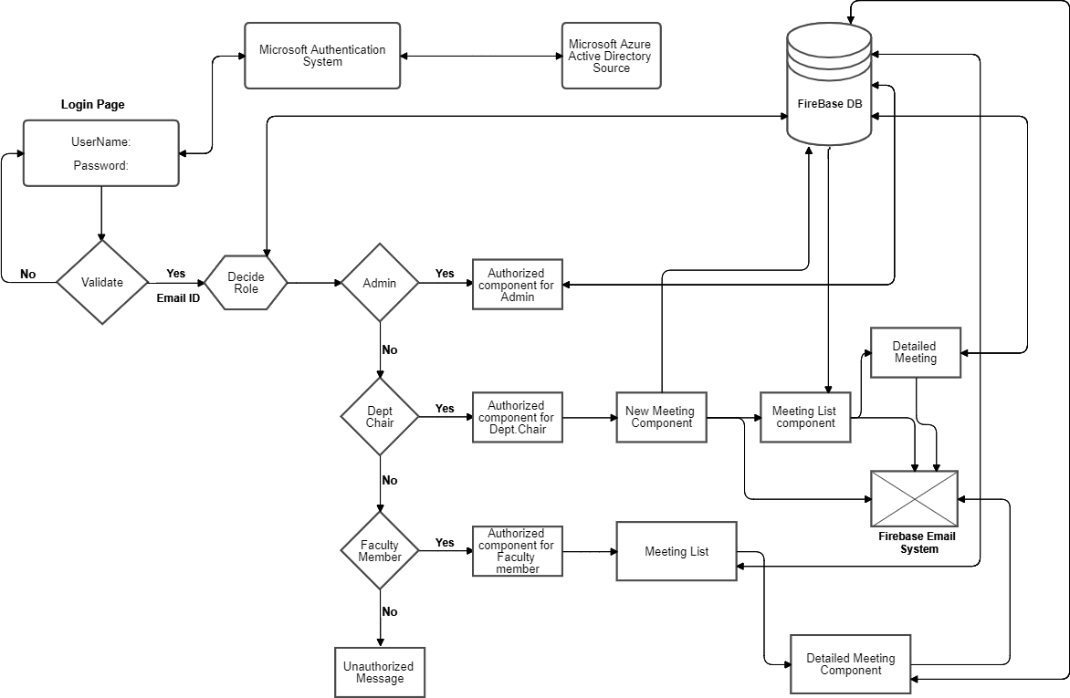
UI Wireframe Design

Slide 11
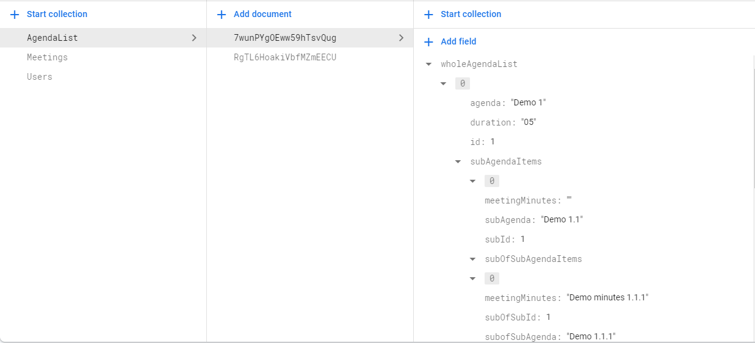
DataBase Design For AgendaList

Slide 12

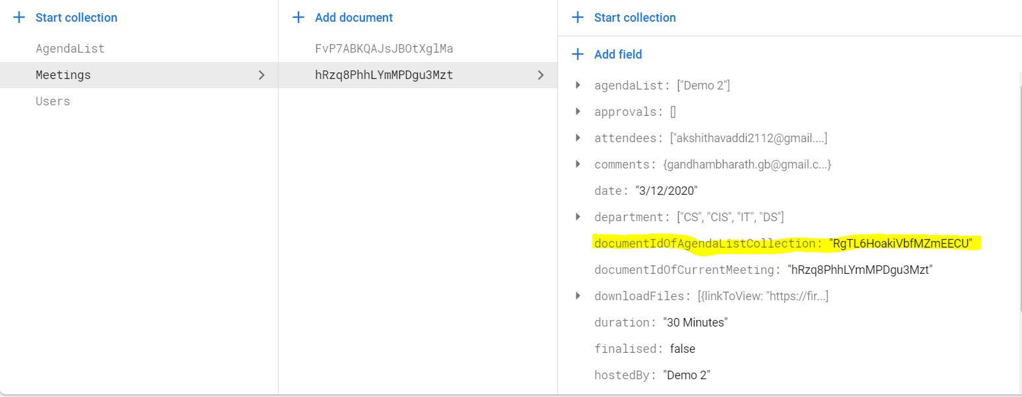
Highlighted is the Reference to Agenda list collection.

Slide 13
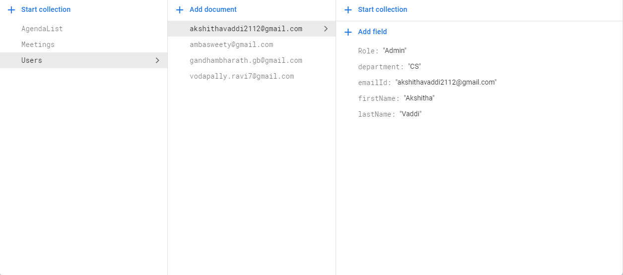
DataBase Design For Users

Slide 14
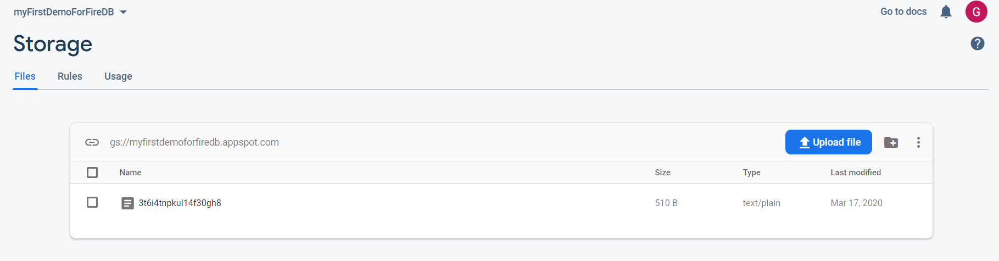
FireDb-Storage (for storing files)

Slide 15
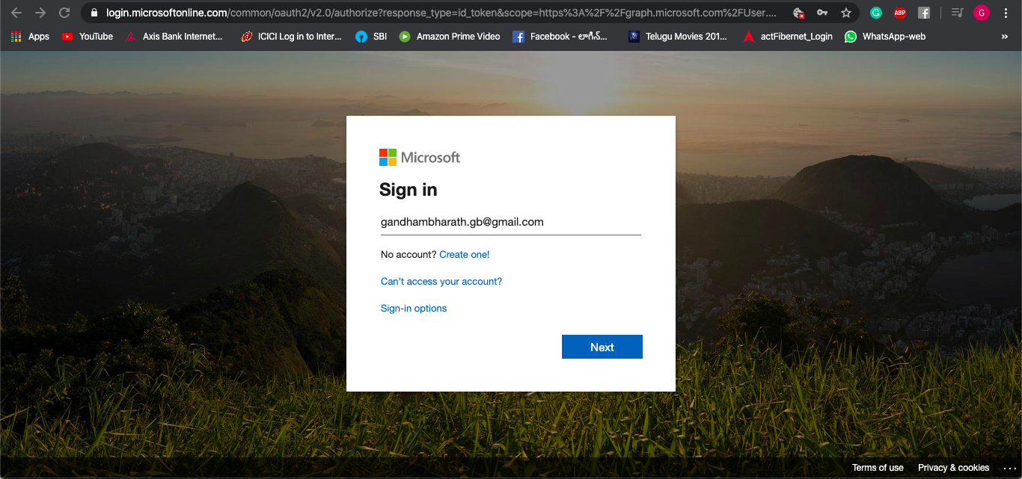
ADMIN Page Implementation Screenshot For Login with Microsoft

Slide 16
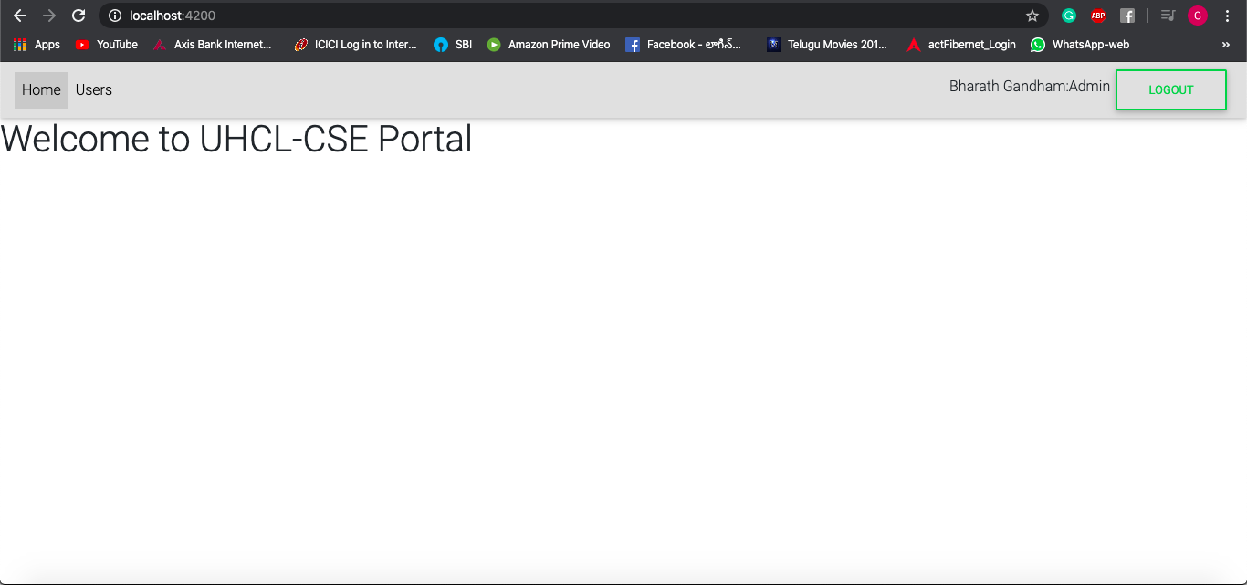
ADMIN Page Implementation Screenshot For Home Component With Nav Bar

Slide 17
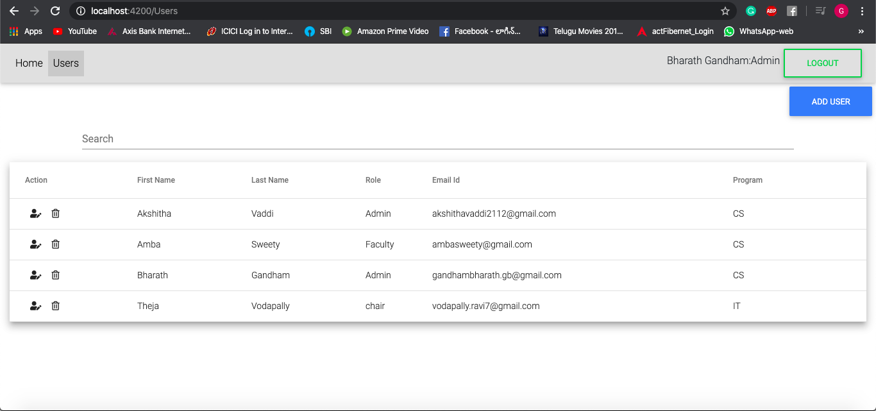
ADMIN Page Implementation Screenshot For Users list

Slide 18
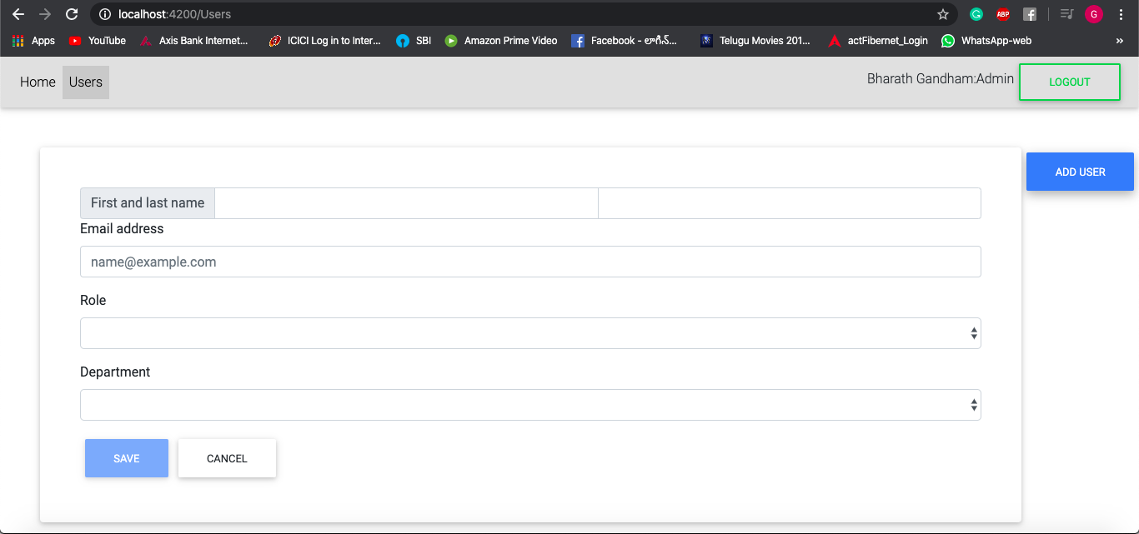
ADMIN Page Implementation Screenshot For Add User

Slide 19
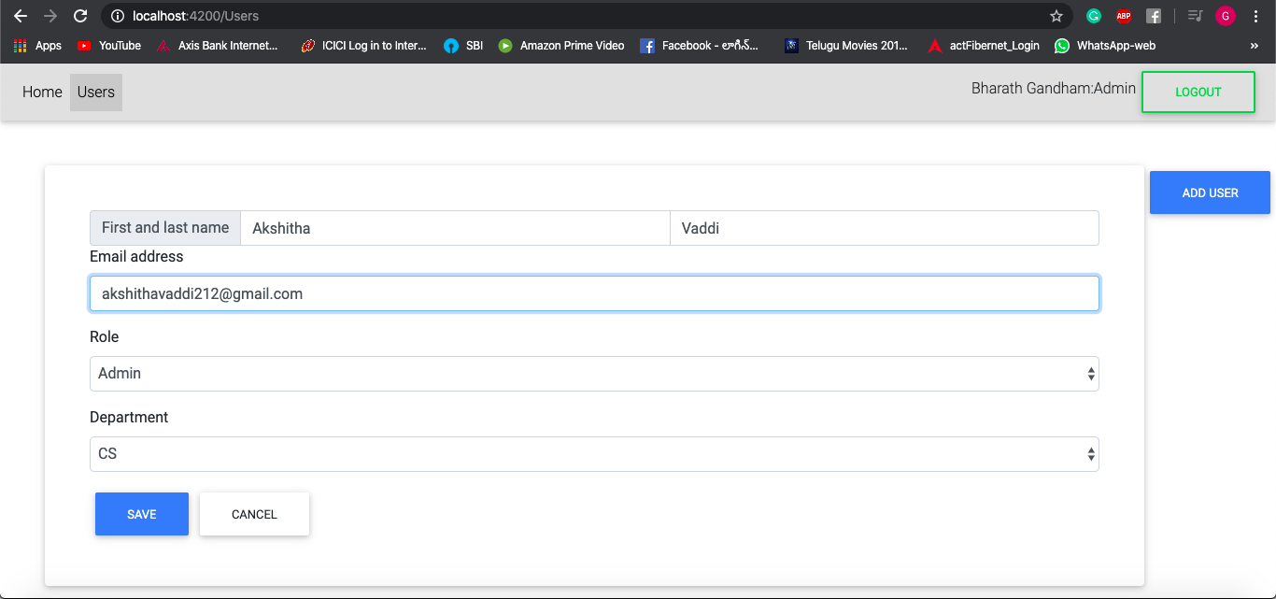
ADMIN Page Implementation Screenshot For EDIT User

Slide 20
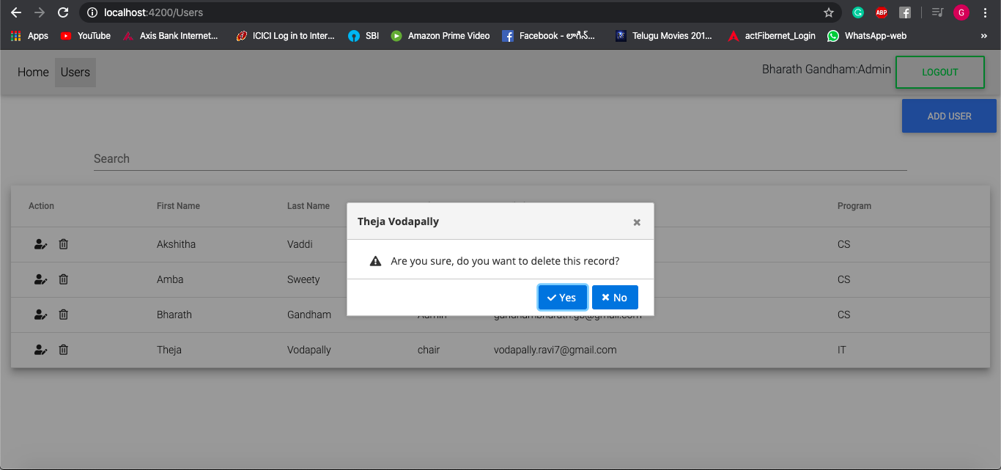
Page Implementation Screenshot For Delete User

Slide 21
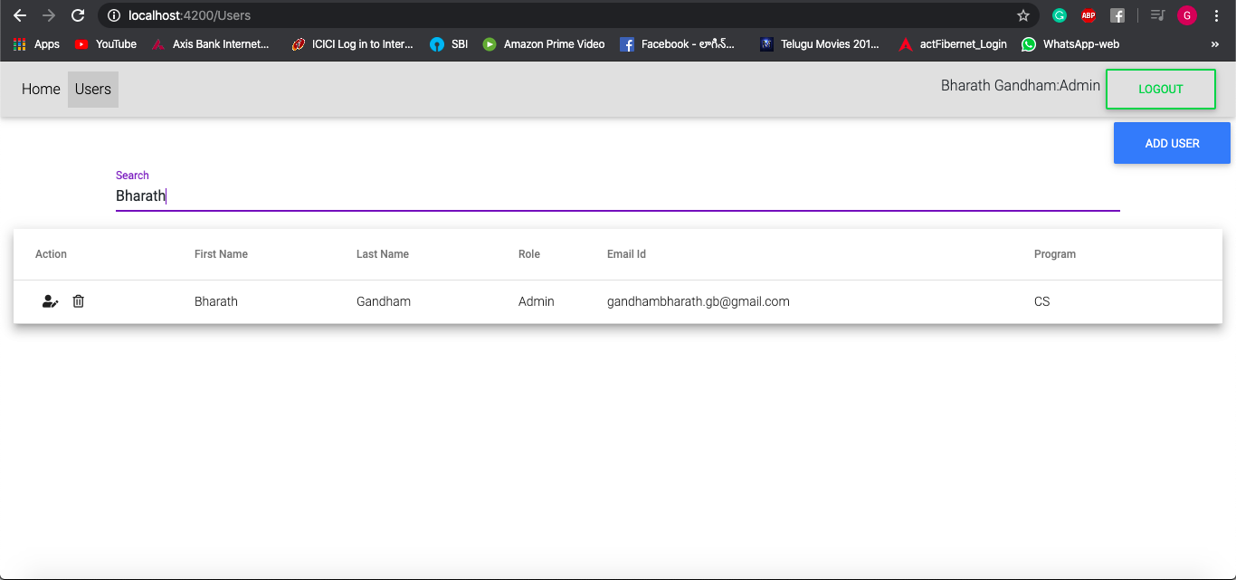
ADMIN Page Implementation Screenshot For Search Functionality

Slide 22
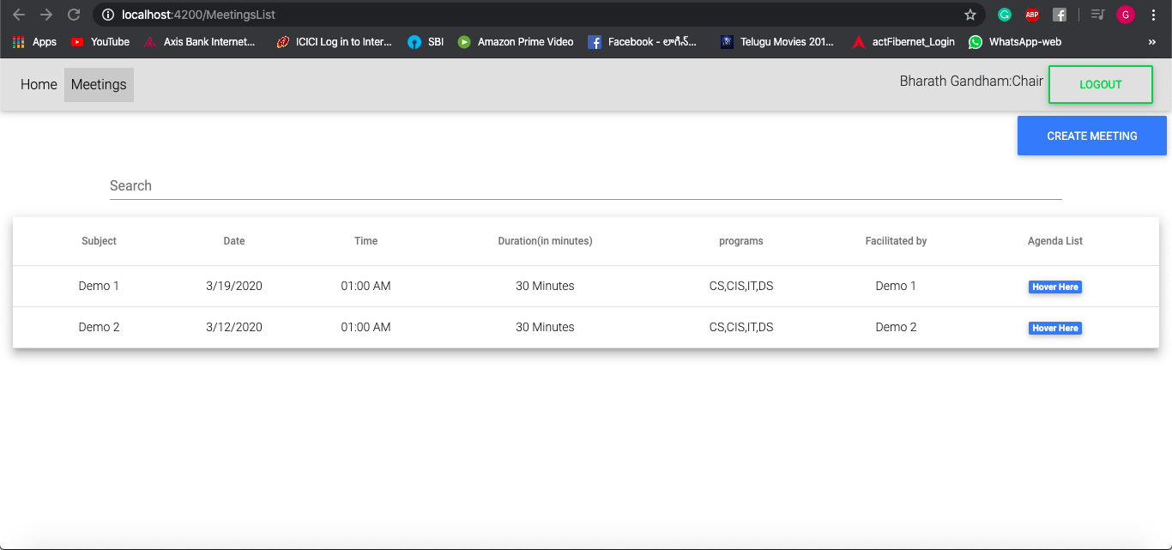
DepT Chair Page Implementation Screenshot For Meetings List with search and Hover over

Slide 23
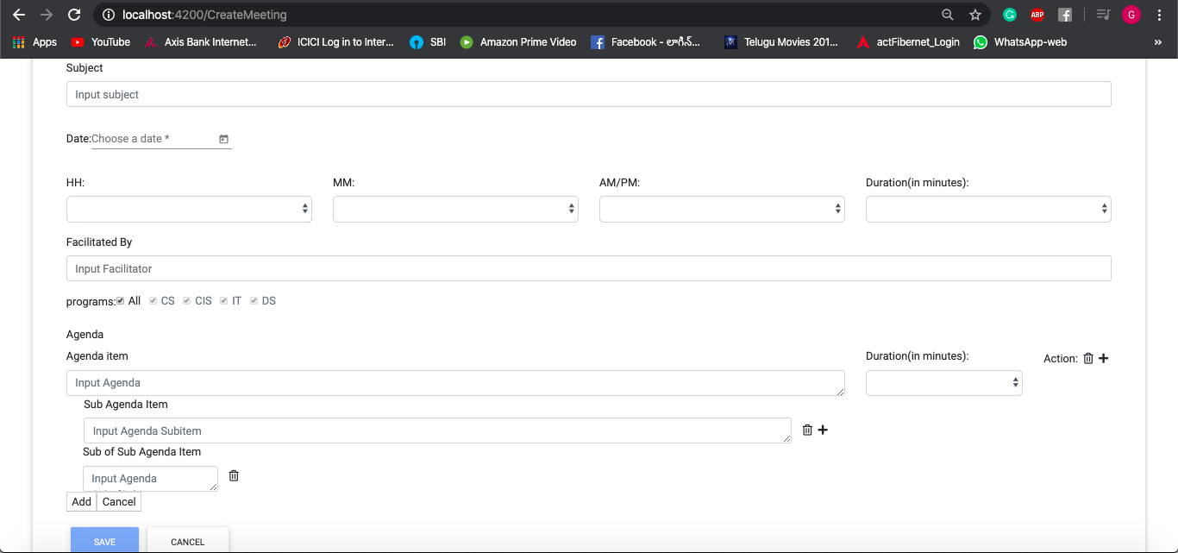
DepT Chair Page Implementation Screenshot For Create Meeting

Slide 24
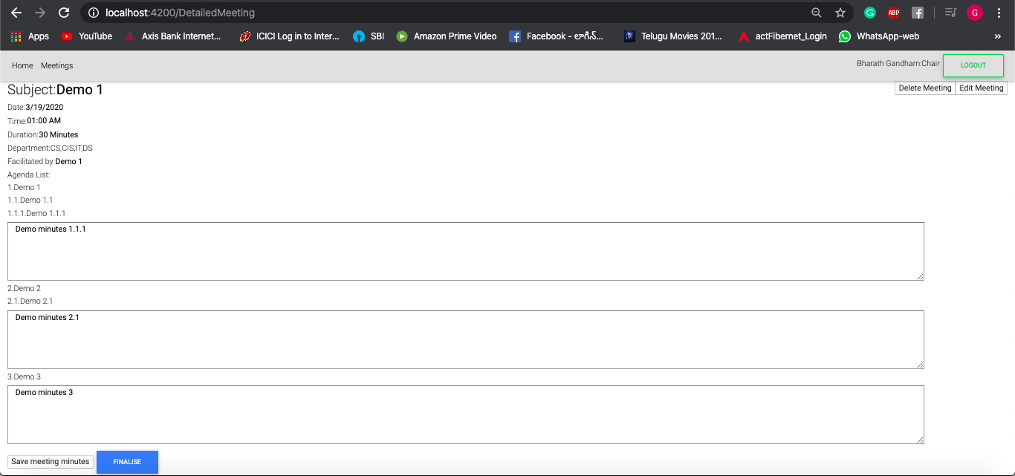
Detailed Meeting-Chair Page Implementation Screenshot For Detailed Meeting with Sample Meeting minutes

Slide 25
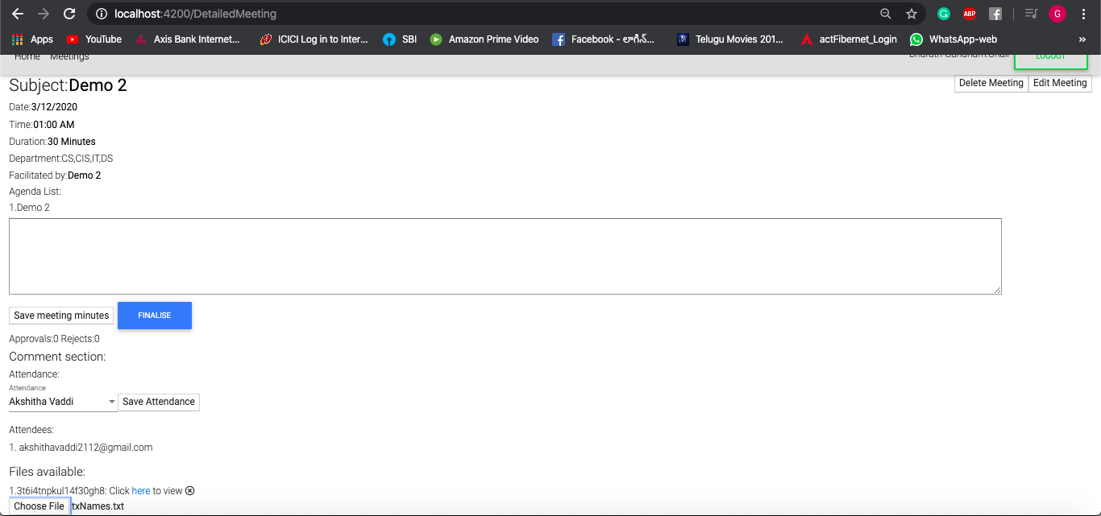
Detailed Meeting-Chair Page Implementation Screenshot For Detailed Meeting with Files available, attendance, comment section

Slide 26
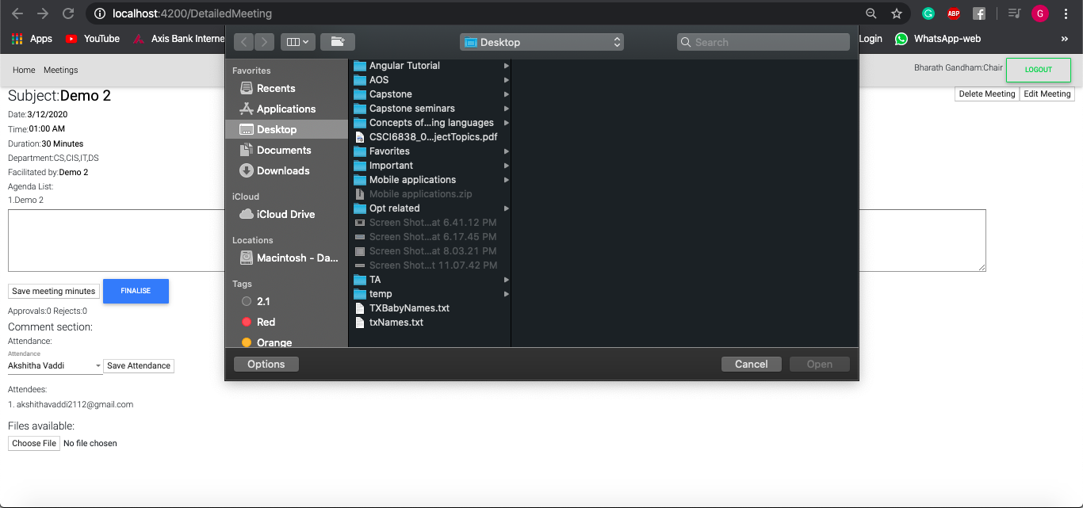
Detailed Meeting-Chair Page Implementation Screenshot For Detailed Meeting with file upload demo

Slide 27
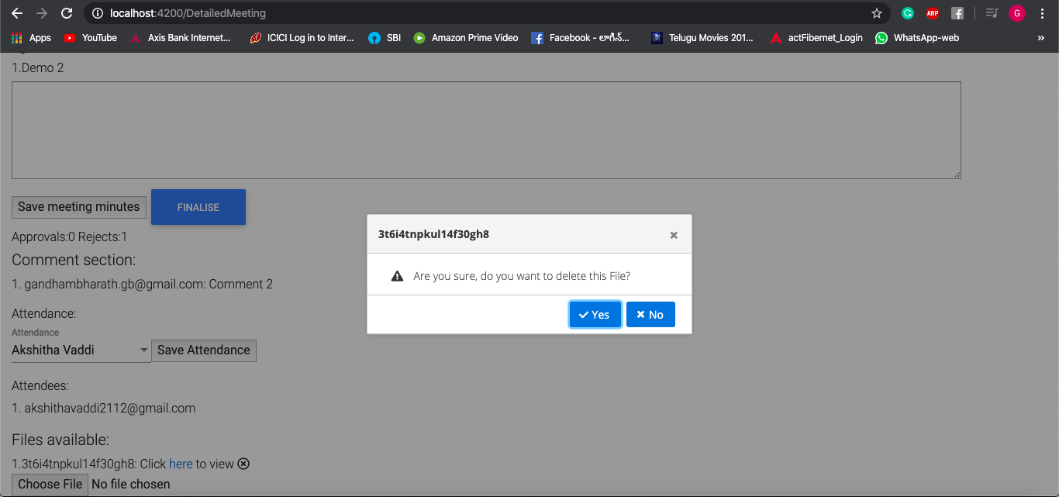
Detailed Meeting-Chair Page Implementation Screenshot For Delete File

Slide 28
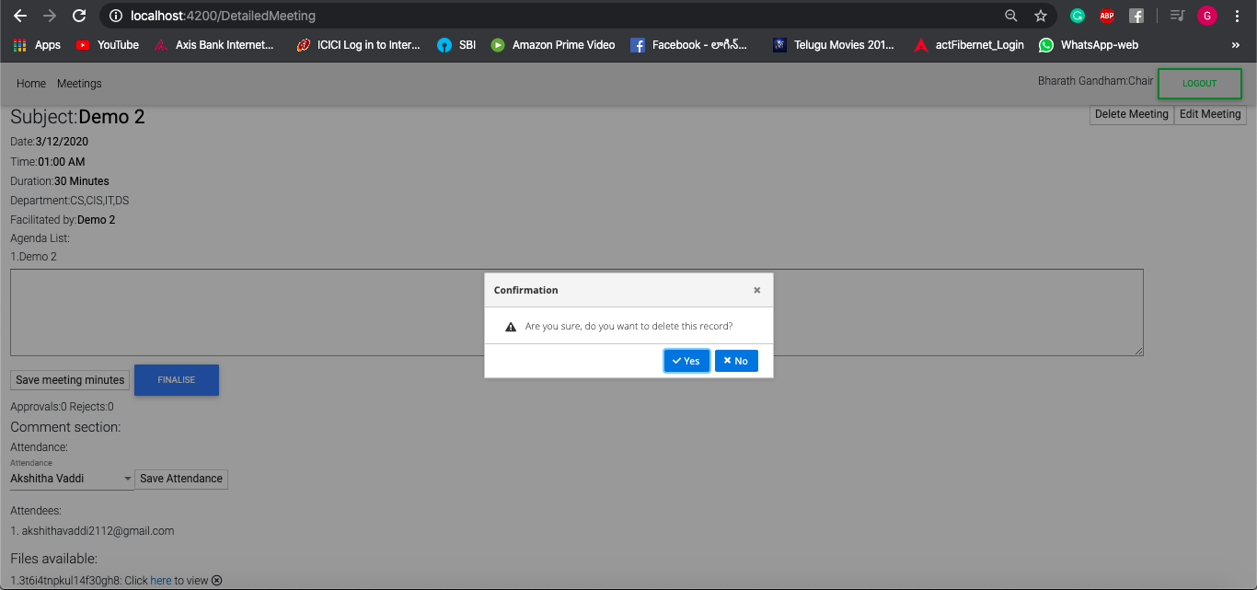
Detailed Meeting-Chair Implementation Screenshot For DELETE MEETING

Slide 29
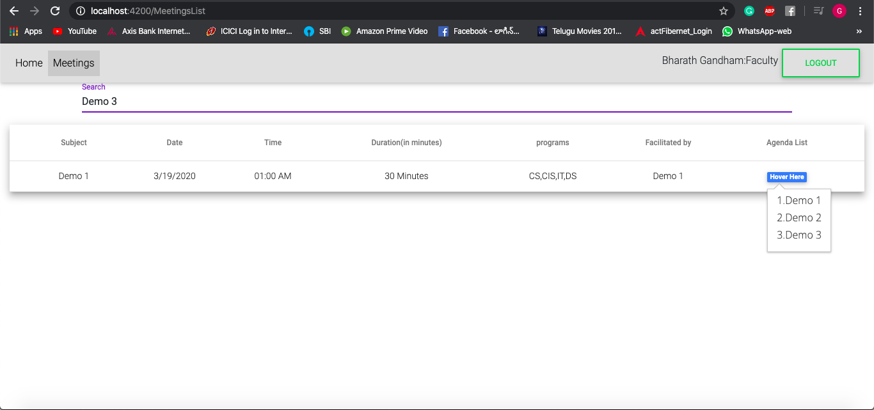
FACULTY Page Implementation Screenshot For Meeting List without create meeting option

Slide 30
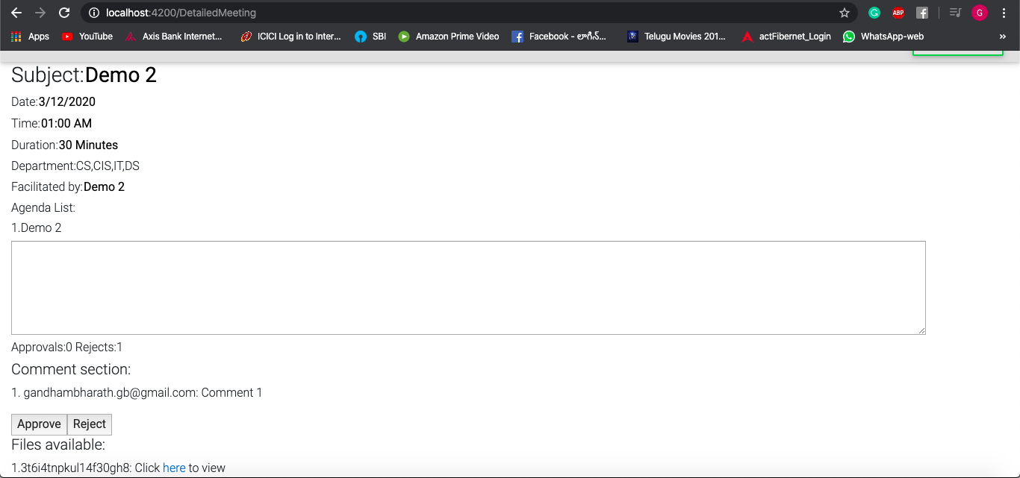
FACULTY Page Implementation Screenshot For Detailed Meeting with comments, Approve and Reject options

Slide 31
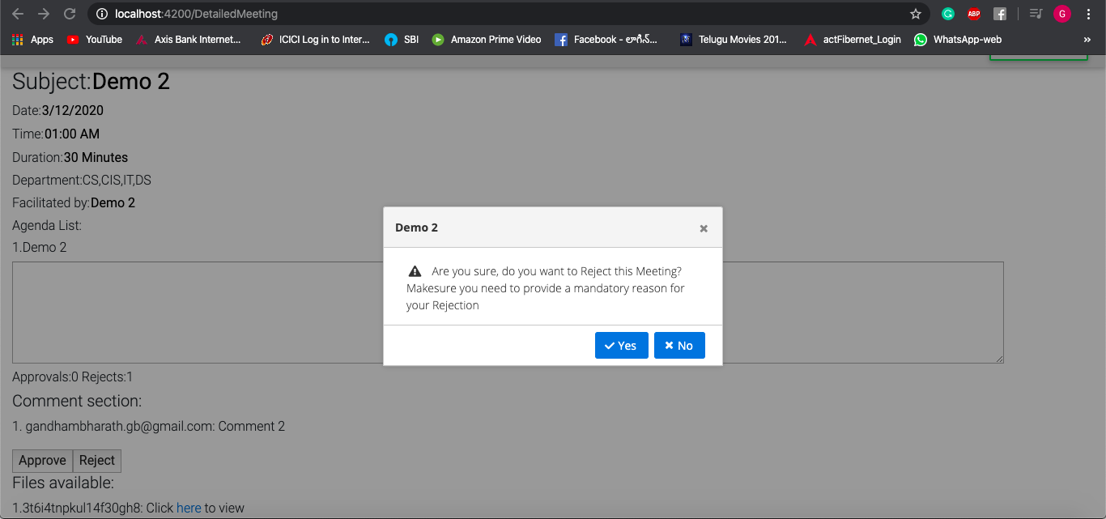
FACULTY Page Implementation Screenshot For Reject Event triggered

Slide 32
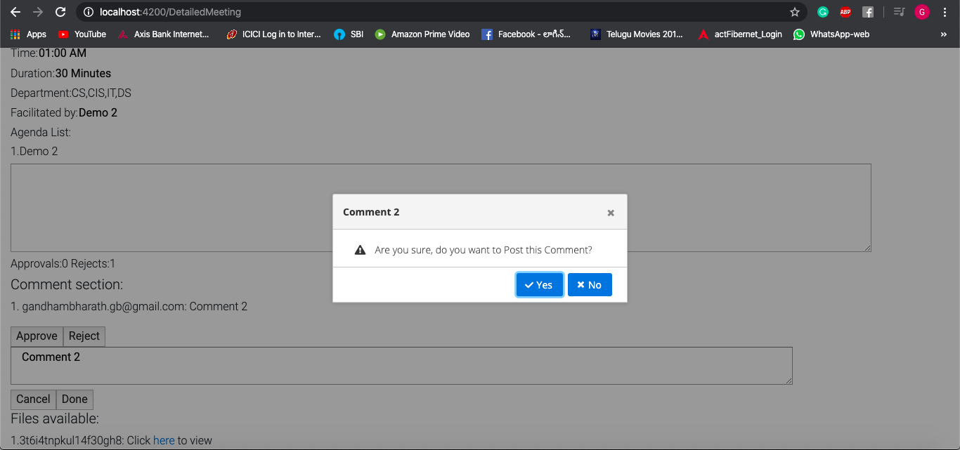
FACULTY Page Implementation Screenshot For Post Comment

Slide 33
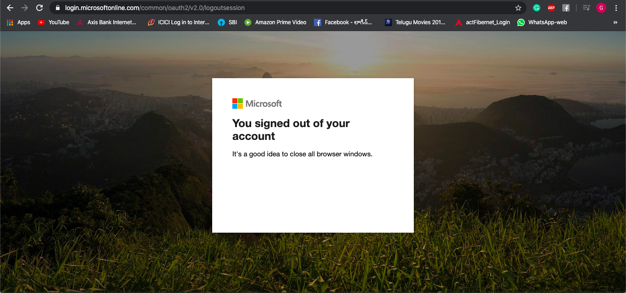
FACULTY Page Implementation Screenshot For Logout triggered

Slide 34
TASK DIVISION
HomeComponent design, Microsoft authentication-Soundarya Ambaraja
UsersList components design, Website UI Design- Akshitha Vaddi
CreateMeeting, DetailedMeeting components design, database design- Bharath Gandham
MeetingList Component design, Email system -RaviTheja Vodapally
Note: These are only the leads for each component.

Slide 35
PROJECT TIMELINE
Task Date | Task Accomplished
January 29, 2020 | Requirements Documentation
February 5, 2020 | UI Design
February 12, 2020 | Getting familiar with Technologies
February 19, 2020 | Static Pages Implementation & Backend(Firebase) integration
February 26, 2020 | Microsoft Authentication, Role based Authorization
March 4, 2020 | Necessary Changes made to UI and included Attendance element
March 11, 2020 | Required Validations, Guards, File upload & Download Elements are included

Slide 36


